Slide 1
Invoice Recording Workflow
Invoice creation in ERP system from sales order data obtained from email in Excel format from Sales Department.
Notes:
Overall process description: When we Sell Goods, we need to prepare invoices and share the invoices with customers for their perusal.
Key steps of the Process in one statement:
Finance dept is processing sales invoices and recording them in invoice management system
Input: Sales data based on goods sold / sales orders. This data is available in Excel for RPA to start the process.
Processing: Invoice preparation from sales data available in Excel. And create those invoices in Invoice Management Application / ERP system (in this case we are using Invoicely.com). RPA will pick up data from Excel, log into Invoicely.com and perform data entry.
Output: As RPA creates invoice records into Invoicely application, they are downloaded into a common folder and a copy of invoice is emailed to respective customers.
-----------

Slide 2
Invoice Creation in ERP and sending to Customers - Demo
Read Sales order Data (Excel)
Create Invoice (ERP System)
Email Invoice to Customer (Email)

Slide 3
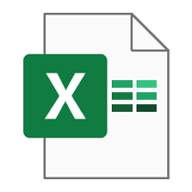



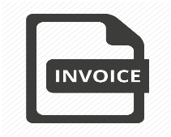



Start
Detailed Steps For Invoice Creation
Read Sales Data from input Excel sheet
If row exists in Excel sheet
Yes
Open Browser and Launch invocely.com
Login to Invoicely on cloud
Fetch details from each row of sales order data
Create New Invoice in Invoicely
Download Invoice to local folder
Mail the invoice to customer
No
Message Box pops up saying No Data In Excel
Close the browser
Stop
Stop
Logout from Invoicely

Slide 4

No of Applications - 4
3 Screens
21 fields
Human – Manual Process
Robots – Digital Workflow Process
19 Click activities
19 Click activities
1 Invoice Data Entry into ERP System
39 Events 1 Min 40 Sec
8 Copy activities
35 Events 35 Sec
10 Copy activities
AHT
AHT
10 Paste activities
8 Paste activities

Slide 5
Key Measures | Per Transaction | For 100 transaction
Total Events | 35 | 3600
Total Fields | 18 | 1800
Average Handling Time(AHT) | 35 Sec | 3500 Sec (58 min)

Slide 7
Effort involved / tasks involved/detailed activities (Per Transaction)
No of Applications | 4 (Excel, Invoicely App, PDF, Email)
No of Screens | 3 (Excel, Invoicely App, Email)
Average Handling Time | 35 Sec
No of fields across all applications | 18
Events: 36, see below for breakup No of Clicks No of Copy activities No of type into activities | 19 9 8
Key Measures | Per Transaction | For 100 transaction
Total Events | 36 | 3600
Total Fields | 18 | 1800
Average Handling Time(AHT) | 35 Sec | 3500 Sec (58 min)
Manual data entry to create 1 invoice → 1min40sec

